Slide 2
Notes:
2
An introduction to database programming
This chapter introduces you to the basic concepts and terms that apply to database applications.
In particular, it explains what a relational database is and how you work with it using SQL, th industry-standard language for accessing data in relational database.
If you have much experience with databse programming, you can just review the figures in this chapter to make sure that you understand everything.
Otherwise, this chapter will give you the background that you need for learning how to develop ADO.NET applications.
To illustrate the required concepts and terms, this chapter presents examples that use Microsoft SQL Server as the database management system.
Because SQL is a standard language, the underlying concepts and terms also apply to database management systems like Oracle or MySQL.

Slide 3
Notes:
3

Slide 4
Notes:
4
An introduction to client/server systems
In case you aren’t familiar with client/server systems, this topic introduces you to their essential hardware and software components.
Then, the rest of this chapter presents additional information on these components and on how you can use them in database applications.
The hardware components of a client/server system
The figure on the slide presents the 3 hardware components of a client/server system: the clients, the network and the server.
The clients are usually the PCs that are already available on the desktops throughout a company.
The network is made up of the cabling, communication lines, network interface cards, hubs, routers, and other components that connect the client and the server.
The server, commonly referred to as a database server, is a computer that has enough processor speed, internal memory (RAM), and disk storage to store the files and databases of the system and provides services to the clients of the system.
This computer is often a high-powered PC, but it can also be a mirange system like an IBM iSeries or a Unix system, or even a mainframe system.
When a system consists of networks, midrange systems, and mainframe systems, often spread throughout the country or world, it is commonly referrred to as an enterprise system.
To back up the files of a client/server system, a server usually has a tape drive or some other form of offline storage.
It often has one or more printers or specialize devices that can be shared by the users of the system. And it can provide programs or servies like email that can be accessed by all the users of the system.
In larger networks, however, features such as backup, printing, and email are provided by separate servers. That way, the database server can be dedicated to the task of handling database requests.
In a simple client/server system, the clients and the server are part of a local area network (LAN). However two ore more LANs that reside at separate geographical locations can be connected as part of a larger network such as a wide area network (WAN). In addition ,individual systems or networks can be connected over the internet.

Slide 5
Notes:
5

Slide 6
Notes:
6
The software components of a client/server system
The figure on the slide presents the software components of a typical client/server system.
In addition to a network operating system that manages the functions of the network, the server requires a database management system (DBMS) like Microsoft SQL Server, Oracle, or MySQL. This DBMS manages the databases that are stored on the server.
In contract to the server, each client requires application software to perform useful work. This can be a purchased software package like a financial accounting package, or it can be custom software that’s developed fo a specific application.
In .Net Advanced you will learn how to use C# for developing custom software for database applications.
Although the application software is run on the client, it uses data that’s stored on the server.
To make this communication between the client and the data source possible for a C# application, the client accesses the database via a data access API such as ADO.NET.
Once the software for both client an server is installed, the client communicates with the server by passing SQL-queries (or just queries) to the DBMS called Structured Query Language (SQL). SQL lets any application communicate with any DBMS.
After the client sends a query to the server, the server responds by sending the results back to the client.
(In conversation, SQL is pronounced as either S-Q-L or sequel)
As you can see on the slide, the processing done by a client/server system is divided between the clients and the server.
In this case, the DBMS on the server is processing requests made by the application running on the client.
Theoretically, at least, this balancs the workload between the clients and the server so the system works more efficiently.
In contrast, in a file-handling system, the clients do all of the work because the server is used only to store the files and are used by the clients.

Slide 7
Notes:
7

Slide 8
Notes:
8
Other client/server system architectures
In its simplest form, a client/server system consists of a single database server and one or more clients.
Many client/server systems today, though, include additional servers.
On the slide, for example, you can see two client/ server systems that include an additional server between the clients and the database server.
The first illustration is for a Windows-based system. With this system, only the user interface for an application runs on the client.
The rest of the process­ing that's done by the application is stored in one or more classes on the appli­cation server. Then, the client sends requests to the application server for processing.
If the request involves accessing data in a database, the application server formulates the appropriate query and passes it on to the database server. The results of the query are then sent back to the application server, which processes the results and sends the appropriate response back to the client.
As you can see in this illustration, two types of classes can be stored on an application server.
Business classes can represent business entities used by an application. For example, an application that accepts invoices for a vendor might use business classes that represent vendors, invoices, and invoice line items. In addition, business classes can implement business rules.
An application server can also be used to store database classes. These classes provide the code that's needed to process the database requests, such as retrieving data from the database and storing data in the database. Because these classes work directly with the database, they are sometimes stored on the database server instead of the application server.

Slide 9
Notes:
9
Other client/server system architectures
Web-based applications use a similar type of architecture, as illustrated by the second example in this figure.
In a web application, a web browser running on the client is used to send requests to a web application running on a web server somewhere on the Internet.
The web browser might also send request to web services running on the web server.
Then, the web application or web service can pass requests for data on to the database server.
Although this figure gives you an idea of how client/server systems can be configured, you should realize that they can be much more complicated than what's shown here.
In a Windows-based system, for example, business classes and database classes can be distributed over any number of application servers, and those classes can communicate with databases on any number of database servers.
Similarly, the web applications and services in a web-based system can be distributed over numerous web servers that access numerous database servers.

Slide 10
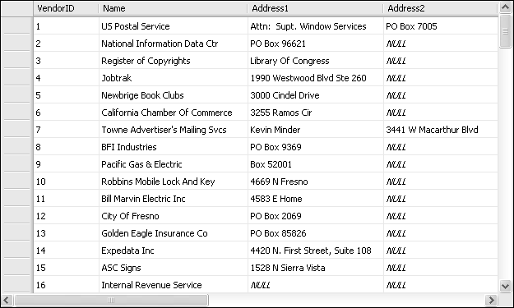
Primary key
Columns
Rows
Notes:
An introduction to relational databases
In 1970, Dr. E. F. Codd developed a model for what was then a new and revolutionary type of database called a relational database.
This type of data­ base eliminated some of the problems that were associated with standard files and other database designs.
By using the relational model, you can reduce data redundancy, which saves disk storage and leads to efficient data retrieval.
You can also view and manipulate data in a way that is both intuitive and efficient.
Today, relational databases are the de facto standard for database applications.
How a table is organized
The model for a relational database states that data is stored in one or more tables.
It also states that each table can be viewed as a two-dimensional matrix consisting of rows and columns.
This is illustrated by the relational table on the slide. Each row in this table contains information about a single vendor.
In practice, the rows and columns of a relational database table are some­ times referred to by the more traditional terms, records and fields.
In fact, some software packages use one set of terms, some use the other, and some use a combination.
If a table contains one or more columns that uniquely identify each row in the table, you can define these columns as the primary key of the table.
For instance, the primary key of the Vendors table in this figure is the VendorID column.
In this example, the primary key consists of a single column. However, a primary key can also consist of two or more columns, in which case it's called a composite primary key.
In addition to primary keys, some database management systems let you define additional keys that uniquely identify each row in a table, called non­ primary keys. In SQL Server, these keys are also called unique keys, and they're implemented by defining unique key constraints (also known simply as unique constraints ).
The main difference between a unique key and a primary key is that a unique key can be null and a primary key can't. If a unique key consists of more than one column, then only one of the columns can have a null value.
Indexes provide an efficient way to access the rows in a table based on the values in one or more columns.
Because applications typically access the rows in a table by referring to their key values, an index is automatically created for each key you define.
However, you can define indexes for other columns as well. If, for example, you frequently need to sort the rows in the Vendors table by zip code, you can set up an index for that column.
Like a key, an index can include one or more columns.

Slide 11
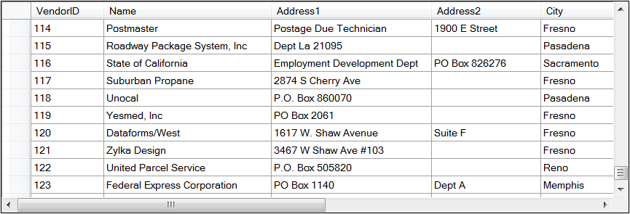
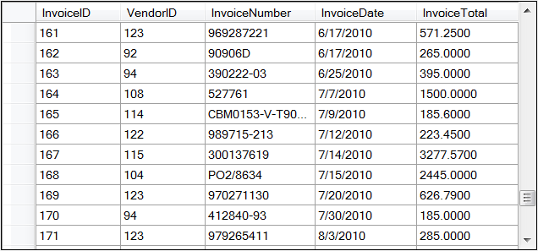
Notes:
11
How the tables in a database are related
The tables in a relational database can be related to other tables by values in specific columns. The two tables shown in the slide illustrate this concept.
Here, each row in the Vendors table is related to one or more rows in an In­voices table. This is called a one-to-many relationship .
Typically, relationships exist between the primary key in one table and the foreign key in another table.
The foreign key is simply one or more columns in a table that refer to a primary key in another table.
In SQL Server, relationships can also exist between a unique key in one table and a foreign key in another table. For simplicity, though, you can assume that the relationships are between primary keys and foreign keys.
One-to-many relationships are the most common type of database relation­ ship.
However, two tables can also have a one-to-one or many-to-many relation­ ship.
If a table has a one-to-one relationship with another table, the data in the two tables could be stored in a single table. Because of that, one-to-one rela­tionships are used infrequently.
In contrast, a many-to-many relationship is usually implemented by using an intermediate table, called a Zinking table, that has a one-to-many relationship with the two tables in the many-to-many relationship.
In other words, a many­ to-many relationship can usually be broken down into two one-to-many rela­tionships.

Slide 12
Notes:
12

Slide 13
Notes:
13
How to Enforce Referential Integrity
Although the primary keys and foreign keys indicate how the tables in a database are related, those relationships aren't enforced automatically.
To enforce relationships, you use referential integrity features like the ones de­ scribed in the slide. Although the features covered here are for SQL Server, most database systems have similar features.
To understand why referential integrity is important, consider what would happen if you deleted a row from the Vendors table and referential integrity wasn't in effect.
Then, if the Invoices table contained any rows for that vendor, those rows would be orphaned.
Similar problems could occur if you inserted a row into the foreign key table or updated a primary key or foreign key value.
To avoid these problems and to maintain the referential integrity of the tables, you can use one of two features: foreign key constraints or triggers.
A foreign key constraint defines how referential integrity should be enforced when a row in a primary key table is updated or deleted.
The most common options are to raise an error if the primary key row has corresponding rows in the foreign key table or to cascade the update or delete operation to the foreign key table.
For example, suppose a user attempts to delete a vendor that has invoices in the Invoices table. In that case, the foreign key constraint can be configured to either raise an error or automatically delete the vendor's invoices along with the vendor. Which option is best depends on the requirements of the application.
Triggers are special procedures that can be executed automatically when an insert, update, or delete operation is executed on a table.
A trigger can deter­mine whether an operation will violate referential integrity. If so, the trigger can either cancel the operation or perform additional actions to ensure that referen­tial integrity is maintained.
Although most database servers provide for foreign key constraints, trig­gers, or both, not all databases take advantage of these features.
In that case, it's up to the application programmer to enforce referential integrity.
For example, before deleting a vendor, your application would have to query the Invoices table to make sure the vendor bas no invoices. Whenever you develop an application that modifies database information, you need to find out what the application's referential integrity requirements are, whether those requirements are implemented in the database by constraints or triggers, and which referen­tial integrity requirements must be implemented in the application's code.

Slide 14
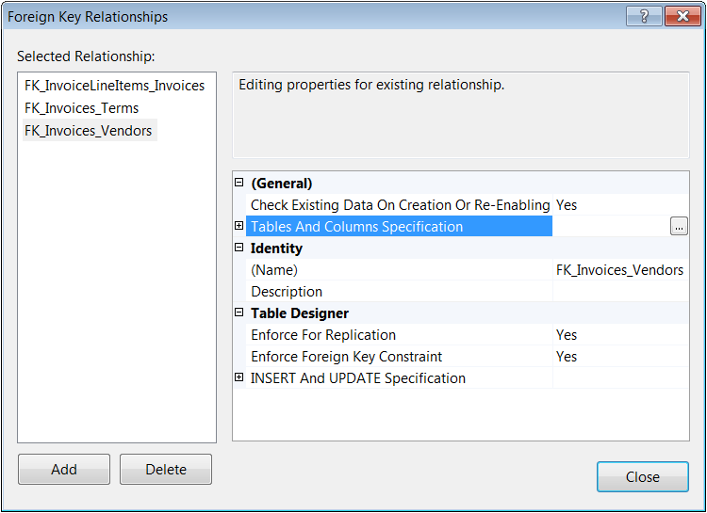
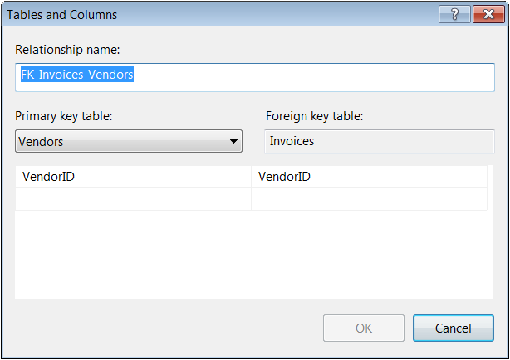
Notes:
14

Slide 15
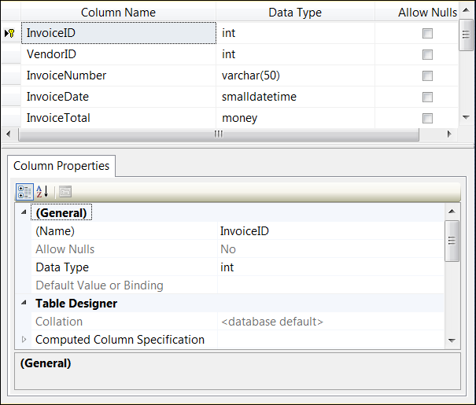
Notes:
15
How the Columns in a table are defined
When you define a column in a table, you assign properties to it as indi­cated by the design of the Invoices table on the slide.
The two most important properties for a column are “Column Name”, which provides an identifying name for the column, and Data Type, which specifies the type of information that can be stored in the column.
With SQL Server, you can choose from system data types like the ones in this figure, and you can define your own data types that are based on the system data types. As you define each column in a table, you generally try to assign the data type that will minimize the use of disk storage because that will improve the performance of the queries later.
In addition to a data type, you must identify whether the column can be null. Null represents a value that's unknown, unavailable, or not applicable. It isn't the same as an empty string or a zero numeric value. Columns that allow nulls often require additional programming, so many database designers avoid columns that allow nulls unless they're absolutely necessary.
You can also assign a default value to each column. Then, that value is assigned to the column if another value isn't provided. If a column doesn't allow nulls and doesn't have a default value, you must supply a value for the column when you add a new row to the table. Otherwise, an error will occur.
Each table can also contain a numeric column whose value is generated automatically by the DBMS.
In SQL Server, a column like this is called an identity column. Identity columns are often used as the primary key for a table.
A check constraint defines the acceptable values for a column.
For example, you can define a check constraint for the Invoices table in this figure to make sure that the InvoiceTotal column is greater than zero.
A check constraint like this can be defined at the column level because it refers only to the column it constrains.
If the check constraint for a column needs to refer to other columns in the table, however, it can be defined at the table level.
After you define the constraints for a database, they're managed by the DBMS (Database management system). If, for example, a user tries to add a row with data that violates a constraint, the DBMS sends an appropriate error code back to the application without adding the row to the database. The application can then respond to the error code.
An altemative to using constraints is to validate the data that is going to be added to a database before the program tries to add it. That way, the constraints shouldn't be needed and the program should run more efficiently. In many cases, both data validation and constraints are used. That way, the programs run more efficiently if the data validation routines work, but the constraints are there in case the data validation routines don't work or aren't coded.

Slide 16
Notes:
16

Slide 17
Notes:
17

Slide 18
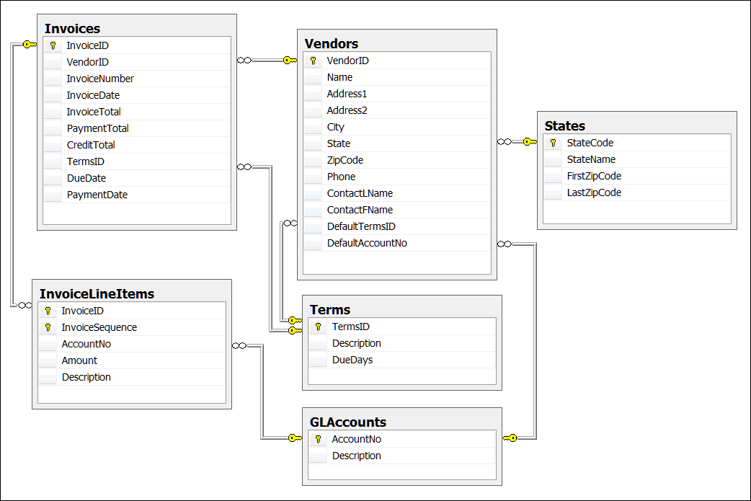
Notes:
18
The design of the Payables database
Now that you've seen how the basic elements of a relational database work, the slide shows the design of the Payables database that we'll use in the programming examples throughout this book.
Although this database may seem complicated, its design is actually much simpler than most databases you'll encounter when you work on actual database applications.
The purpose of the Payables database is to track vendors and their invoices for the payables department of a small business.
The top-level table in this database is the Vendors table, which contains one row for each of the vendors the company purchases from.
For each vendor, this table records the vendor's name, address, phone number, and other information.
The primary key for the Vendors table is the VendorID column. This column is an identity column, so SQL Server automatically generates its value whenever a new vendor is created.
Information for each invoice received from a vendor is stored in the In­voices table.
Like the Vendors table, the primary key for this table, lnvoiceID, is an identity column.
To relate each invoice to a vendor, the Invoices table includes a VendorID column. A foreign key constraint is used to enforce this relationship. That way, an invoice can't be added fora vendor that doesn't exist, and vendors with outstanding invoices can't be deleted.
The InvoiceLineltems table contains the line item details for each invoice.
The primary key for this table is a combination of the InvoiceID and InvoiceSequence columns.
The InvoiceID column relates each line item to an invoice, and a foreign key constraint that cascades updates and deletes from the Invoices table is defined to enforce this relationship.
The InvoiceSequence column gives each line item a unique primary key value.
Note, however, that this column is not an identity column. As a result, the application programs that create line items must calculate appropriate values for this column.
The other three tables in the Payables database (States, Terms, and GLAccounts) provide reference information for the Vendors, Invoices, and InvoiceLineitems tables.
The States table has a row for each state in the U.S.
The primary key for this table is StateCode.
Each Vendor has a State column that relates the vendor to a row in the States table.
The Terms table records invoice terms, such as "Net Due 10 Days" or "Net Due 90 Days."
The primary key of this table is TermslD, which is an identity column. Each invoice also has a TermsID column that relates the invoice to a row in the Terms table.
In addition, each Vendor has a DefaultTermsID column that provides the default terms for new invoices for that vendor .
Finally, the GLAccounts table provides general-ledger account information for the Payables database.
The primary key of this table is AccountNo.
Each InvoiceLineItem also includes an AccountNo column that specifies which account the purchase should be charged to, and each Vendor has a DefaulAccountNo column that provides a default account number for new invoices.
The foreign key constraints that enforce the relationships between the GLAccounts table and the Vendors and InvoiceLineitems tables are defined so that updates are cascaded to those tables. That way, if an account number changes, that change is reflected in the related vendors and line items.

Slide 19
Notes:
19
How to use SQL to work with a relational database
In the topics that follow, you'll leam about the four SQL statements that you can use to manipulate the data in a database: Select, Insert, Update, and Delete.
As you'll learn later in this course, you can often let Visual Studio gener­ate the SQL statements for you based on the selections you make. To master the material in this course, however, you need to understand what these statements do and how they're coded.
Although SQL is a standard language, each DBMS is likely to have its own SQL dialect, which includes extensions to the standard language.
So when you use SQL, you need to make sure that you're using the dialect that's supported by your DBMS.
In this chapter and throughout this book, all of the SQL ex­amples are for Microsoft SQL Server's dialect, which is called Transact-SQL.
How to Query a single table
The slide shows how to use a Select statement to query a single table in a database.
In the syntax summary, you can see that the Select clause names the columns to be retrieved and the From clause names the table that contains the columns.
You can also code a Where clause that gives criteria for the rows to be selected.
And you can code an Order By clause that names one or more columns that the results should be sorted by and indicates whether each column should be sorted in ascending or descending sequence.
If you study the Select statement below the syntax summary, you can see how this works.
Here, the Select statement retrieves columns from the Invoices table. It selects a row only if the row has a balance due that's greater than zero. And it sorts the returned rows by invoice date in ascending sequence (the default).
Please note in this Select statement that the last column in the query, BalanceDue, is calculated by subtracting PaymentTotal and CreditTotal from InvoiceTotal. In other words, a column by the name of BalanceDue doesn't actually exist in the database. This type of column is called a calculated col­umn, and it exists only in the results of the query.

Slide 20
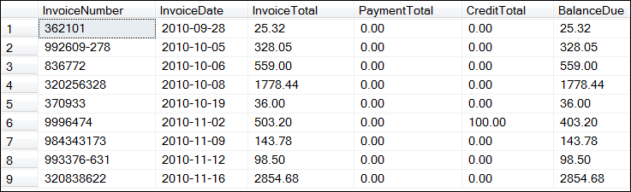
Notes:
20
This figure also shows the result table, or result set, that's returned by the Select statement.
A result set is a logical table that's created temporarily within the database.
When an application requests data from a database, it receives a result set.

Slide 21
Notes:
21

Slide 22
Notes:
22
How to join data from two or more tables
The slide presents the syntax of the Select statement for retrieving data from two tables.
This type of operation is called a join because the data from the two tables is joined together into a single result set.
For example, the Select statement in this figure joins data from the Invoices and Vendors table into a single result set.
An inner join is the most common type of join. When you use an inner join, rows from the two tables in the join are included in the result set only if their related columns match.
These matching columns are specified in the From clause of the Select statement.
In the Select statement in this figure, for ex­ample, rows from the Invoices and Vendors tables are included only if the value of the VendorID column in the Vendors table matches the value of the VendorlD column in one or more rows in the lnvoices table. If there aren't any invoices fora particular vendor, that vendor won't be included in the result set.
Although this figure shows how to join data from two tables, you should know that you can extend this syntax to join data from additional tables.
If, for example, you want to include data from the InvoiceLineltems table in the results shown in this figure, you can code the From clause of the Select state­ment like this:
From Vendors
Join Invoices on Vendors.VendorID = Invoices.VendorID
Join InvoiceLineitems on Invoices.InvoiceID = InvoiceLineitems.InvoiceID
Then, in the column list of the Select statement, you can include any of the columns in the lnvoiceLineltems table.

Slide 23
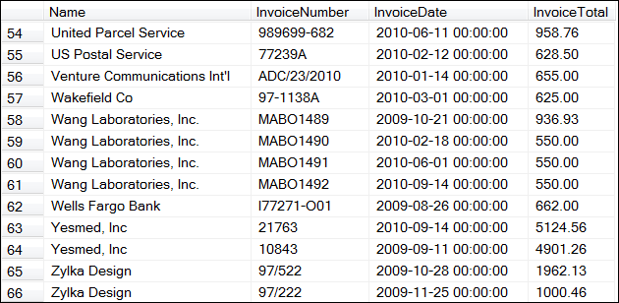
Notes:
23

Slide 24
Notes:
24

Slide 25
Notes:
25
How to add, update, and delete data in a table
This and the next two slides present the basic syntax of the SQL Insert, Update, and Delete statements.
You use the Insert statement to insert one or more rows into a table.
As you can see (in this and the next slide), the syntax of this statement is different depending on whether you're adding a single row or selected rows.
To add a single row to a table, you specify the name of the table you want to add the row to, the names of the columns you're supplying data for, and the values for those columns.
The example in this figure adds a row to the Terms table. Because the value of the TermsID column is generated automatically, though, it's not included in the Insert statement.
If you're going to supply values for all the columns in a table, you can omit the column names, but then you must be sure to specify the values in the same order as the columns appear in the table.
Note that you typically use single quotes to identify strings. For example, the string for the Description column is enclosed in single quotes.
However, if a string value contains a single quote, you'll need to replace the single quote with two single quotes.

Slide 26
Notes:
26
How to add, update, and delete data in a table
To add selected rows to a table, you include a Select statement within the Insert statement.
Then, the Select statement retrieves data from one or more tables based on the conditions you specify, and the Insert statement adds rows with that data to another table.
In the example in this figure, the Select state­ment selects all the columns from the rows in the Invoices table that have been paid in full and inserts them into a table named InvoiceArchive.

Slide 27
Notes:
27
How to add, update, and delete data in a table
To change the values of one or more columns in a table, you use the Update statement.
On this statement, you specify the name of the table you want to update, the names of the columns you want to change and expressions that indicate how you want to change them, and a condition that identifies the rows you want to change.
In the example in this figure, the Update statement changes the TermsID value to 4 for each row in the Invoices table that has a TermsID value of 1.

Slide 28
Notes:
28
How to add, update, and delete data in a table
To delete rows from a table, you use the Delete statement.
On this state­ment, you specify the table you want to delete rows from and a condition that indicates the rows you want to delete.
The Delete statement in this figure deletes all the rows from the Invoices table that have been paid in full.

Slide 29
Notes:
29
How to work with other database objects and functions
In addition to the tables you've already learned about, relational databases can contain other database objects like views, stored procedures, and triggers.
You can also use functions to work with the data in a database. In the topics that follow, you'll be introduced to these objects and functions.
How to work with Views
A view is a predefined query that's stored in a database.
To create a view, you use the Create View statement as shown in the slide.
This statement causes the Select statement you specify to be stored in the database.
In this case, the Create View statement creates a view named VendorsMin that retrieves three columns from the Vendors table.
To access a view, you issue a Select statement that refers to the view.
This causes a virtual table (a temporary table that's created on the server) to be created from the Select statement in the view.
Then, the Select statement that referred to the view is executed on this virtual table to create the result set.
Although views can be quite useful, they require some additional overhead.
That's because every time an application refers to a view, the view bas to be created from scratch. If that's a problem, an alternative is to use stored proce­dures.

Slide 30
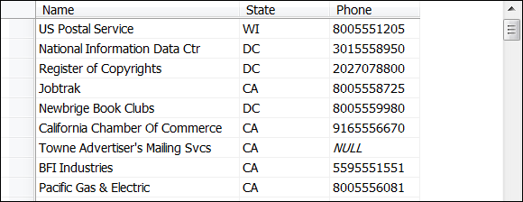
Notes:
30

Slide 31
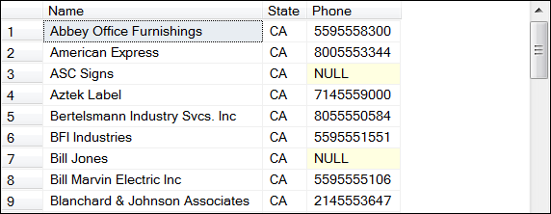
Notes:
31

Slide 32
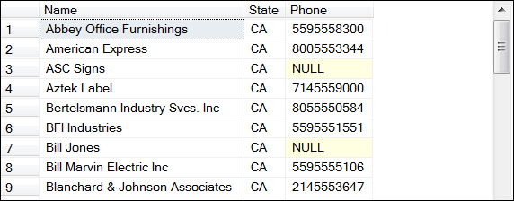
Notes:
32
How to work with stored proecedures and triggers
A stored procedure is a set of one or more SQL statements that are stored together in a database.
To create a stored procedure, you use the Create Proce­dure statement as shown in the slide.
Here, the stored procedure contains a single Select statement.
To use the stored procedure, you send a request for it to be executed.
When the server receives the request, it executes the stored procedure. If the stored procedure contains a Select statement like the one in this figure, the result set is sent back to the calling program.
If the stored procedure contains Insert, Update or Delete statements, the appropriate processing is performed.
Notice that the stored procedure in this figure accepts an input parameter named @State from the calling program.
The value of this parameter is then substituted for the parameter in the Where clause so only vendors in the speci­fied state are included in the result set.
When it's done with its processing, a stored procedure can also pass output parameters back to the calling program.
In addition, stored procedures can include control-of­ flow language that determines the processing that's done based on specific conditions.
A trigger is a special type of stored procedure that's executed automatically when an insert, update or delete operation is performed on a table.
Triggers are used most often to validate data before a row is added or updated, but they can also be used to maintain the relationships between tables.
Although you don't work with triggers directly from an application program, you need to know what triggers exist for the tables in a database and what operations they per­ form.
That way, you’ll know what processing an application needs to do before it updates the table.

Slide 33
Notes:
33

Slide 34
Notes:
34
How to work with functions
The slide introduces you to three types of Functions that you can use when you code SQL statements.
Only a few of the functions that are available are displayed for each function type.
Please note that all functions return a single value.

Slide 35
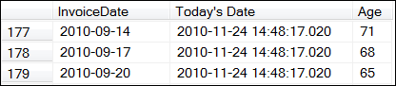
Notes:
35
How to work with functions
To illustrate, the first coding example in this figure is a Select statement that uses three scalar functions.
These are functions that can operate on the data in a single row.
Here, the GETDATE function is used to get the current date, which is displayed in the second column of the result set.
Then, the GETDATE function is used as a parameter for the DATEDIFF function, which returns the number of days between the date in the InvoiceDate column and the current date.

Slide 36
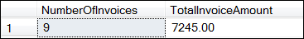
Notes:
36
How to work with functions
In contrast, this coding example is a SELECT statement that uses two aggregate functions.
These are functions that can operate on the data in two or more rows.
In this case, the COUNT function returns the number of rows selected by the query, and the SUM function returns the sum of the values in the InvoiceTotal column of the selected rows.

Slide 37
Notes:
37
System functions
The last category of functions is the category of system functions that are available with SQL Server.
Each database management system bas its own system functions.
Both functions (@@Identity and INDENT_CURRENT(‘table_name’)) return the last value that was generated for an identity column.
As you may remember from the previous slides, an identity column is a numeric column whose value is generated automatically when a row is added to a table.
As a result, you can use one of these functions to find out what the generated number is after you add a row to a table.
User definded functions
Besides the three types of functions, you can create user-defined functions that are stored with the database.
These functions are most often written and used by SQL programmers within the stored procedures and triggers that they write.
Although user-defined functions can also be used by application pro­grammers, there are no examples of their use in this course.

